Slide 1
Trenberth Diagram
Week 1: Monday 24th November- Friday 29th November

Slide 2
Brief
Develop data visualisation tools for SpeedyWeather
Use Makie to create useful visualisations that can be called during a script e.g. globe()
Focus is on software engineering rather than science discovery

Slide 3
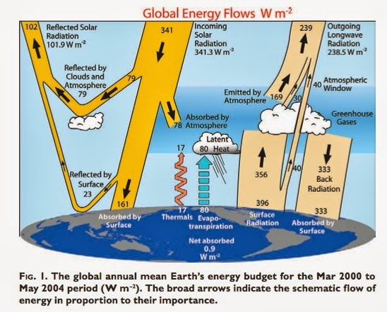
Project 1: Trenberth Diagram
Run SpeedyWeather across a time period e.g. 30 days
Integrate the fluxes depicted in the Trenberth diagram globally to produce a Trenberth visualisation.
Consider grid box sizes
HEALPix grid = all grid boxes are the same size
FullClenshaw Grid = regular longitude-latitude grid → could integrate globally in spectral space and then transform back to linear space
Create a function that when called produces a Trenberth Diagram
Develop the function to be interactive e.g. the user could remove sea ice and run the simulation over a set time period→ this would produce a video/gif of the Trenberth diagram changing through time

Slide 5
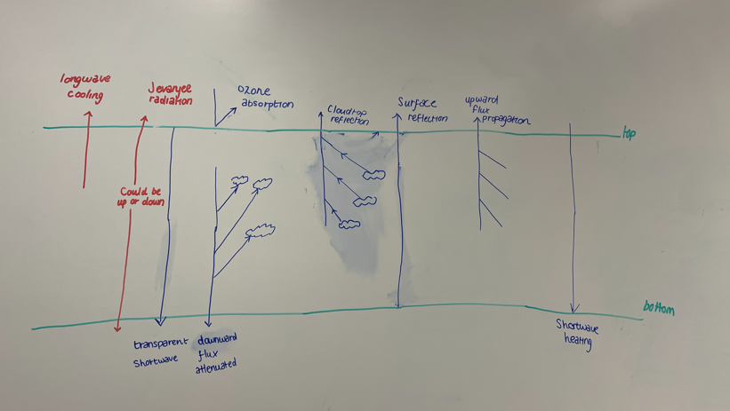

Slide 6
Shortwave radiation
Downwards (from space to Earth) | Upwards (reflected from Earth to space)
Reality Solar radiation (0.48 microns) reaches Earth and passes through the atmosphere Attenuation of shortwave radiation through 3 processes Reflection Scattering → randomised change in direction of solar beam, dependent on size of scattering particle and wavelength of radiant energy Absorption → radiation is transformed into heat by the absorption of certain gases at specific wavelengths e.g. almost all UV radiation (<0.29 microns) are absorbed by ozone | Reality Shortwave adiation is reflected by the Earth’s albedo - (fraction of incident radiation reflected by the surface, ratio of reflected to received radiation) Main contributors to albedo: - snow (75-95%), cumuliform cloud (70-90%), grassland (15-25%), forest (10-20%)
SpeedyWeather Shortwave radiation→ OneBandShortwave parameterisation Calculate incoming solar flux at the top of the atmosphere using astronomical formulae (solar constant x solar zenith angle) Subtract ozone absorption in stratosphere Remaining downward flux is propagated through 8 tropospheric layers using transmissivity Transmissivity considers ‘zenith angle, layer depth, humidity and cloud properties’ There are 2 schemes, one uses a transparent atmosphere, the other removes absorption from aerosols, water vapour and clouds. | SpeedyWeather Top layer of atmosphere contains a cloud reflection term Bottom layer of atmosphere contains surface albedo term and stratocumulus reflection
Notes:
Wien’s law- wavelength of maximum emission is inversely proportional to temperature
Hotter bodies emit short wavelengths
Cooler bodies emit longer wavelengths
Stefan-Boltzmann Law – The energy emitted by a body is directly proportional to the fourth power of the temperature of that body (5.67 x10^8 T^4)
Kirchoff’s Law – strong reflectors are weak absorbers
Raleigh Scattering
Mie Scattering

Slide 7
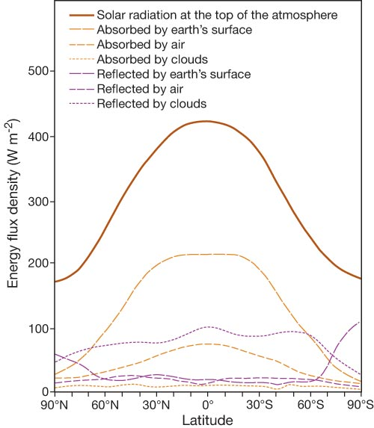
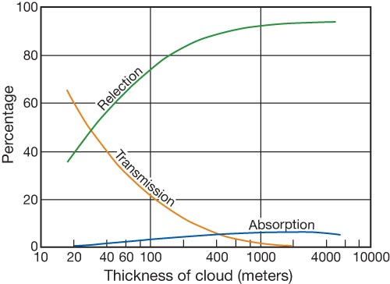
Shortwave radiation: Reality

Slide 8
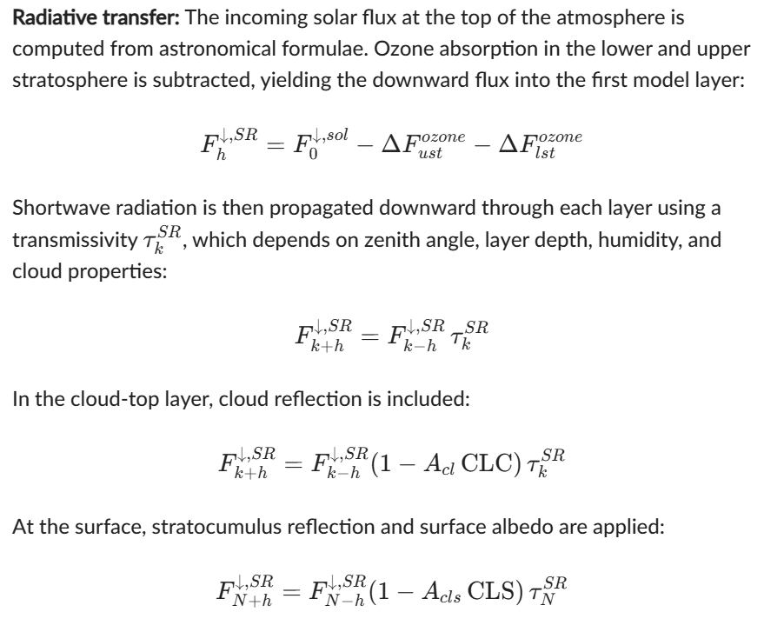
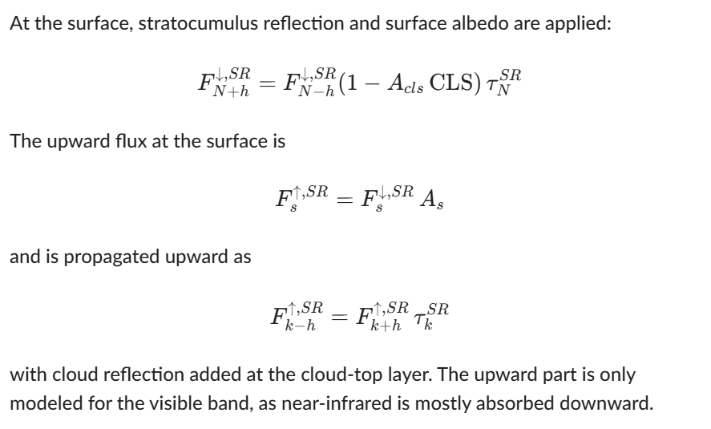
Shortwave radiation: SpeedyWeather

Slide 9

Longwave Radiation
Upward From surface to atmosphere and space | Downward From atmosphere back to surface
Reality A proportion of incoming shortwave radiation is absorbed by the Earth’s surface and by parts of the atmosphere (mainly clouds, aerosols, ozone, and some lower-atmospheric gases). The surface warms and emits upward longwave radiation according to Stefan–Boltzmann’s law (the warmer the surface, the more longwave it emits). Greenhouse gases and clouds absorb longwave radiation and re-emit it both upward and downward. Upward longwave radiation escapes to space or is absorbed by higher atmospheric layers. Downward longwave radiation is absorbed by the surface, which then warms and emits its own upward longwave radiation. | Reality The atmosphere absorbs energy and emits downward longwave radiation. Greenhouse gases absorb longwave radiation and re-emit it in any directions, including downward toward the surface. Clouds behave like strong longwave emitters and produce downward longwave fluxes
SpeedyWeather – Jeevanjee Radiation parameterisation Uniform cooling parameterisation → all parts of Earth has a cooling of -1.5K/day Jeevanjee and Zhou parameterisation scheme → dT → ‘change in flux depends on temperature (T)’ F → ‘vertical upward flux between 2 layers’ ‘A layer below a higher temperature would flux into colder layers above as long as its temperature T > Tt

Slide 10
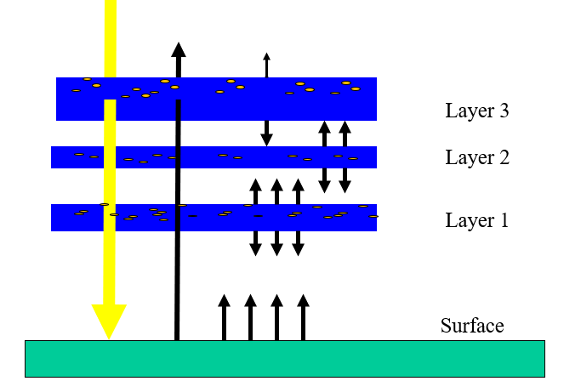
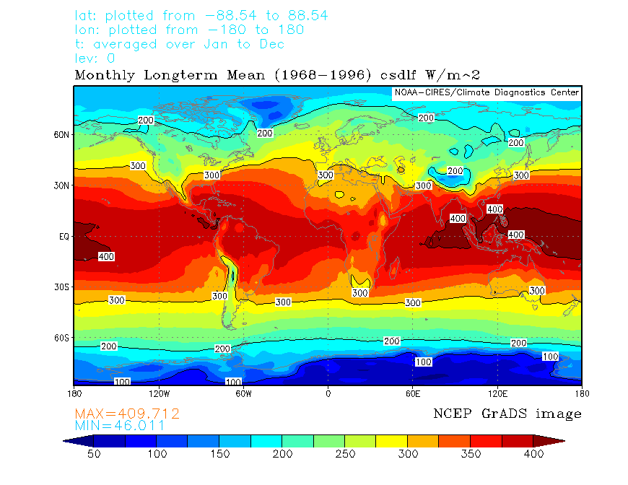
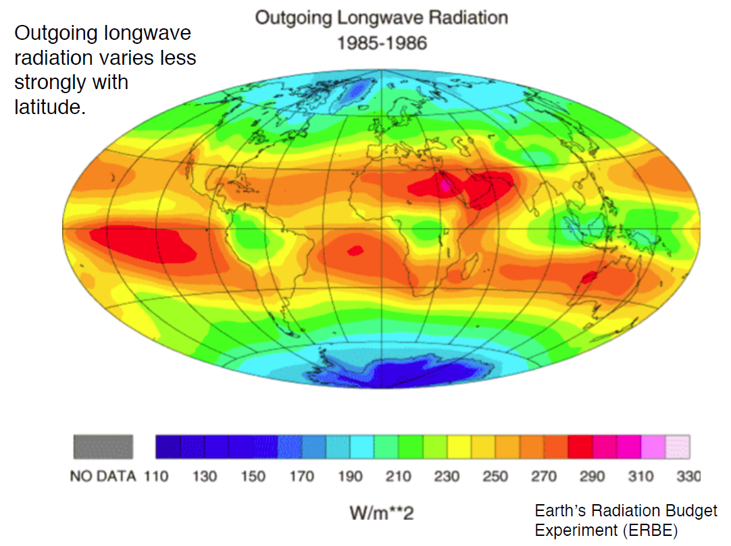
Longwave radiation: Reality

Slide 11
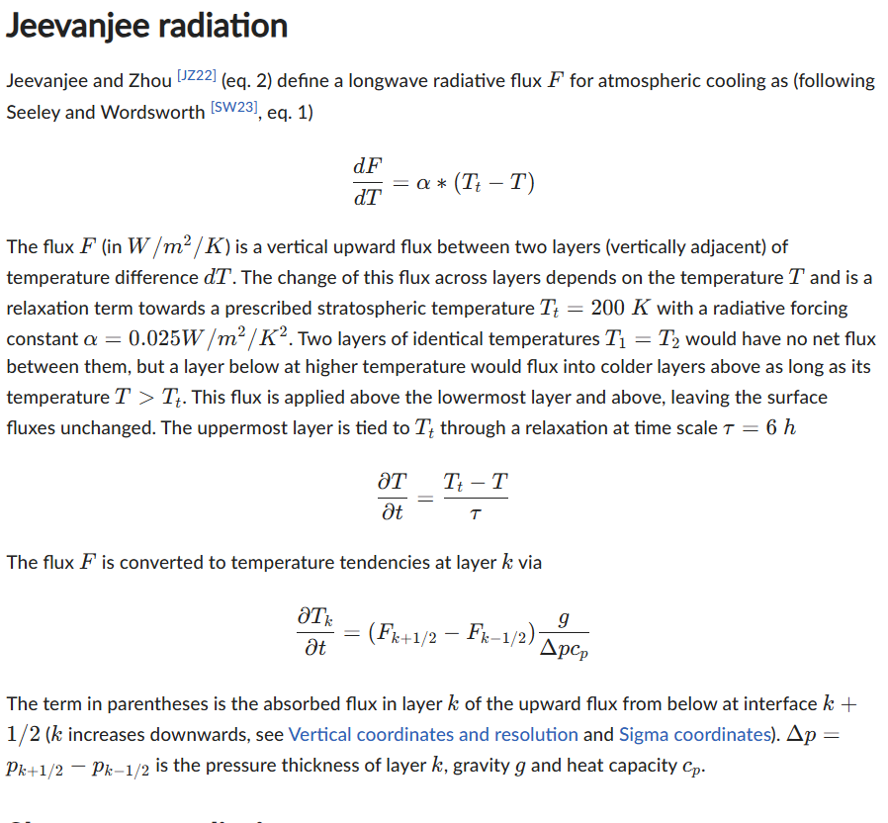
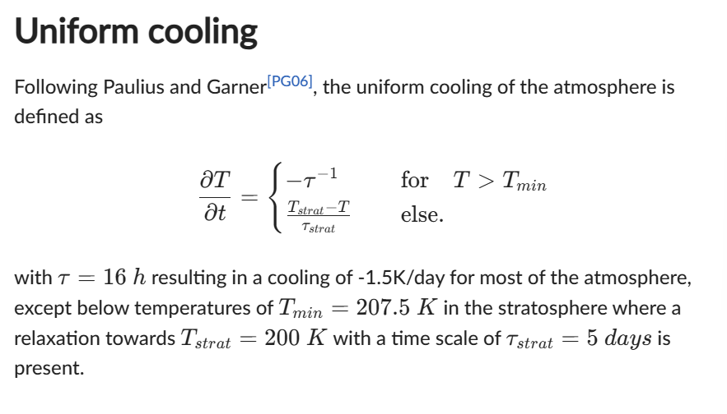
Longwave radiation: SpeedyWeather

Slide 12
Project Development
Phase 1

Slide 13
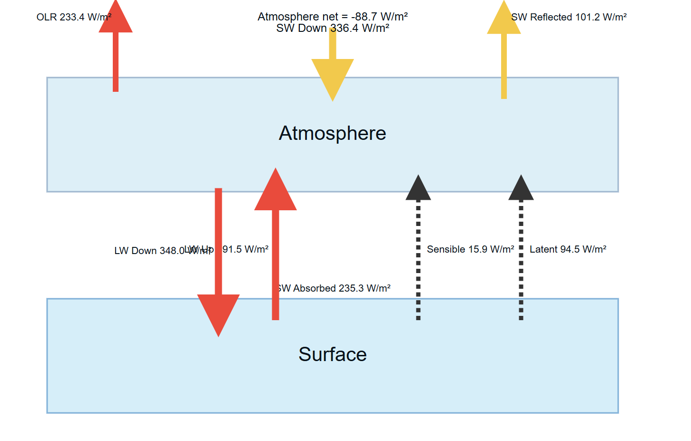
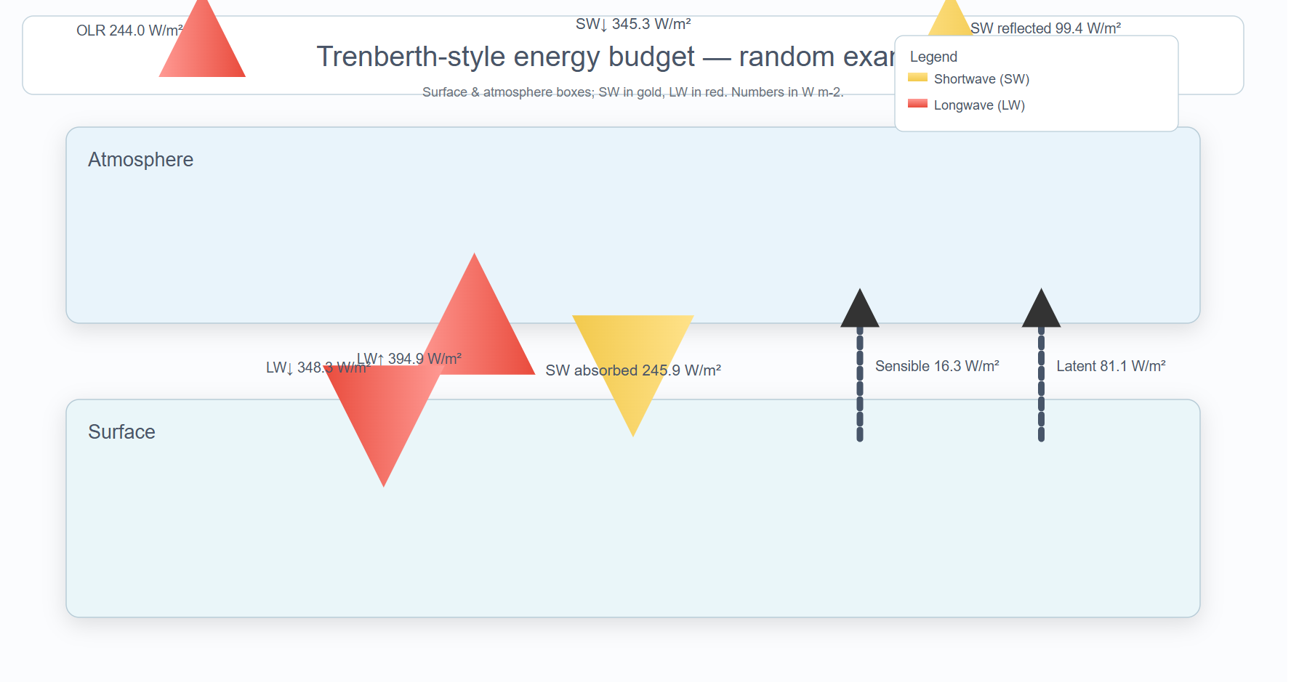
Initial plot visualisation attempts
Using fixed values - no SpeedyWeather interaction
Tuesday 25th and Wednesday 26th November

Slide 14
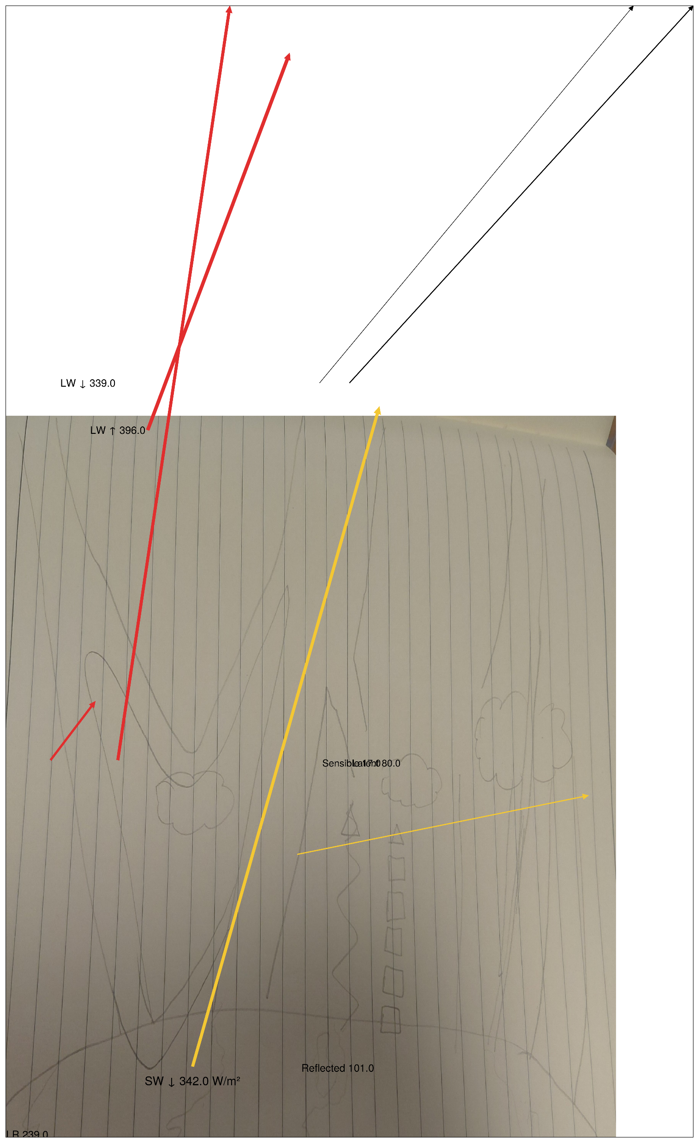
Attempt to plot arrows on top of hand drawn image

